Slide 1
Smart Weather Monitoring System
Team Members:
Komal Rane -18101B0002
Nitesh Pednekar-18101B0026

Slide 2
Content
Introduction
Circuit Diagram
Hardware Used
Software Used
Contribution
Actual Model
ScreenShots

Slide 3
Introduction
Weather monitoring system deals with detecting and gathering various weather parameters which can be analyzed or used for weather forecasting.
The main aim of the project is to develop a smart weather monitoring system.The parameters which would be monitored by the system will include temperature,pressure and humidity of the surroundings.A similar dataset is also visualized in python.

Slide 4
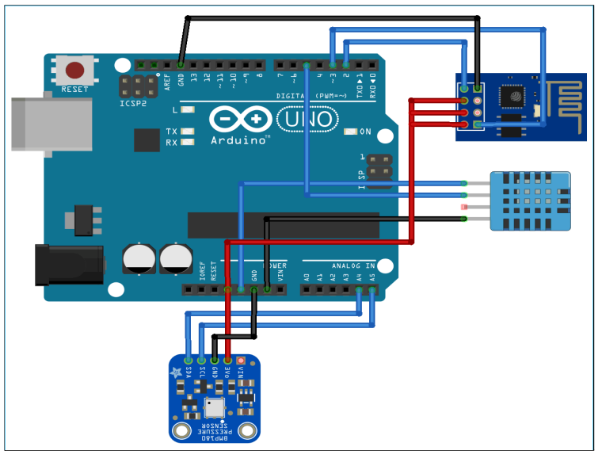
Circuit Diagram

Slide 5
Hardware
Arduino Uno - 600 Rupees
DHT11 Sensor - 100 Rupees
BMP180 Sensor- 200 Rupees
ESP8266- 220 Rupees
Connecting Wires-100 Rupees
Breadboard- 80 Rupees
Arduino Uno Connecting Wires- 100 Rupees

Slide 6
Sofware
Arduino IDE
ThingSpeak
Jupyter Notebook

Slide 7
Project Contribution
The project work was equally divided in group members.The hardware connections of the model was performed by all the project members.
The implementation of the hardware and connections to system, connecting the code to the hardware and report formation all was done with contributed efforts from all team members.

Slide 8
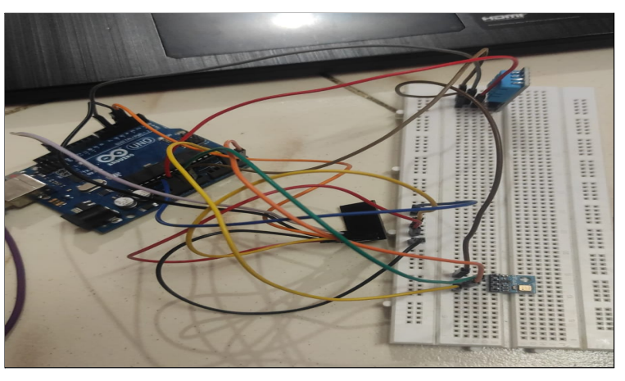
Actual Model

Slide 9
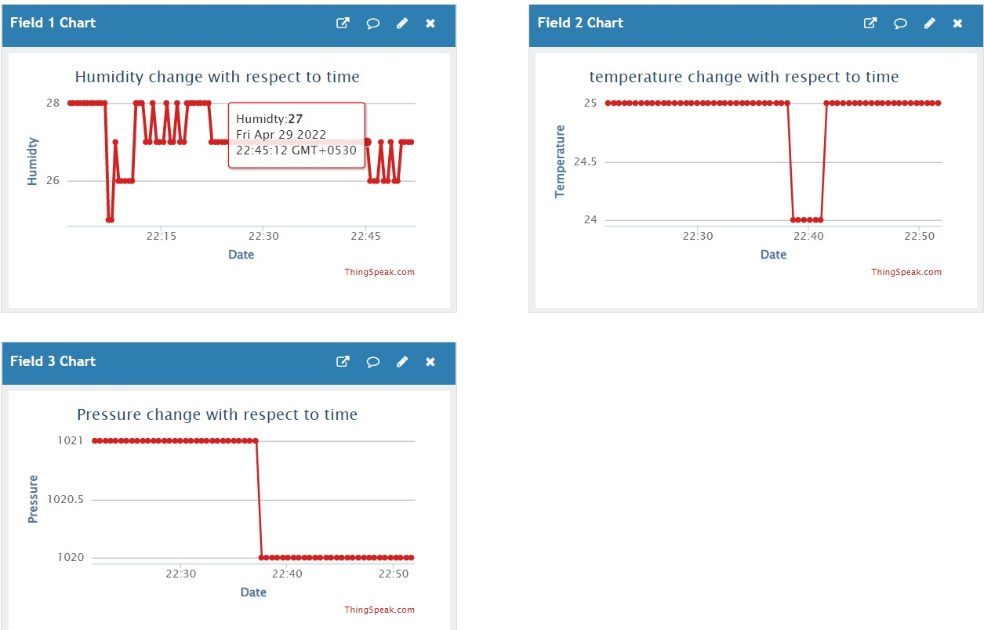
ThingSpeak Dashboard

Slide 10
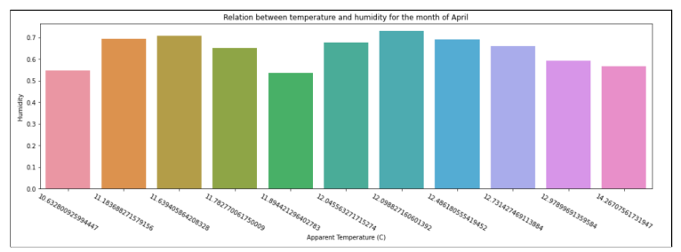
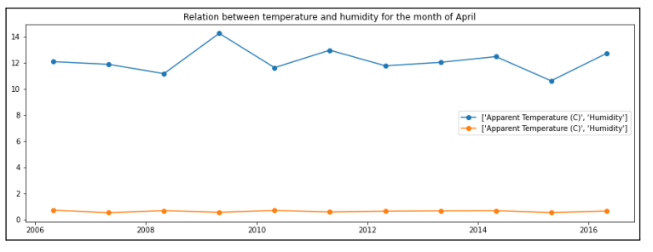

Slide 11
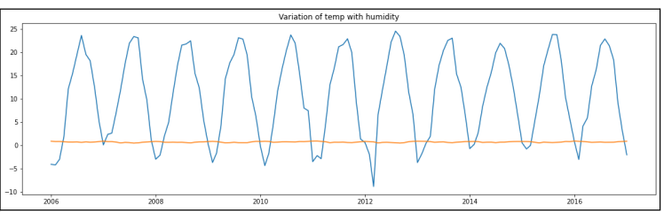

Slide 12
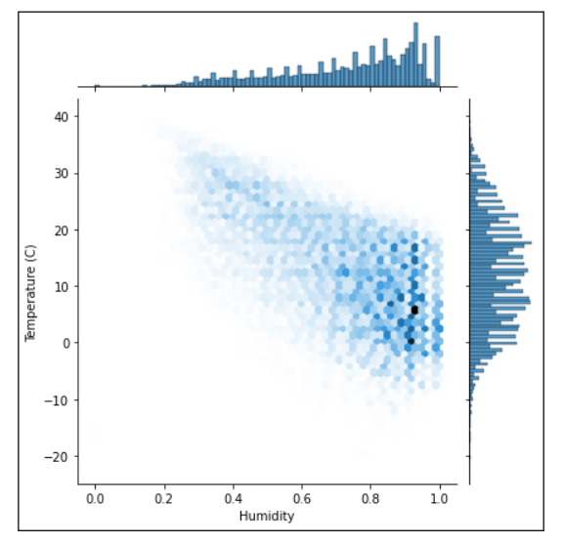
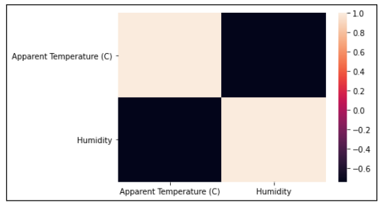

Slide 13
Python Models Used
Random Forest:It is a Supervised Machine Learning Algorithm that is used widely in Classification and Regression problems. It builds decision trees on different samples and takes their majority vote for classification and average in case of regression.
Accuracy Achieved: 86%
Logistic Regression: Logistic regression is a process of modeling the probability of a discrete outcome given an input variable.
Accuracy Achieved: 82%

Slide 14
Thank You!

